Slide 1
Lecture 18
Other Data Structures

Slide 2
Topics: the following data structures:
Dictionary
Properties
BitSet
Rope
SkipList
Disjoint Set
Cuckoo Hashing
Quad Edge
Doubly connected edge list (DCEL)
Unions
Shortest Path Maps
Huffman Trees

Slide 3
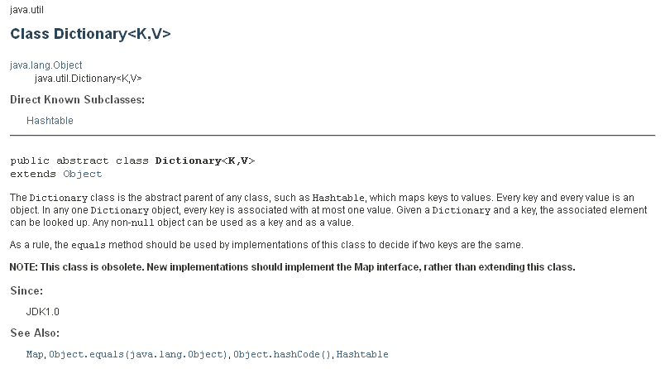
Dictionary – abstract class that maps keys to values

Slide 4
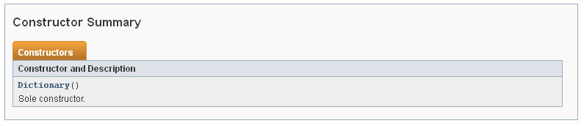
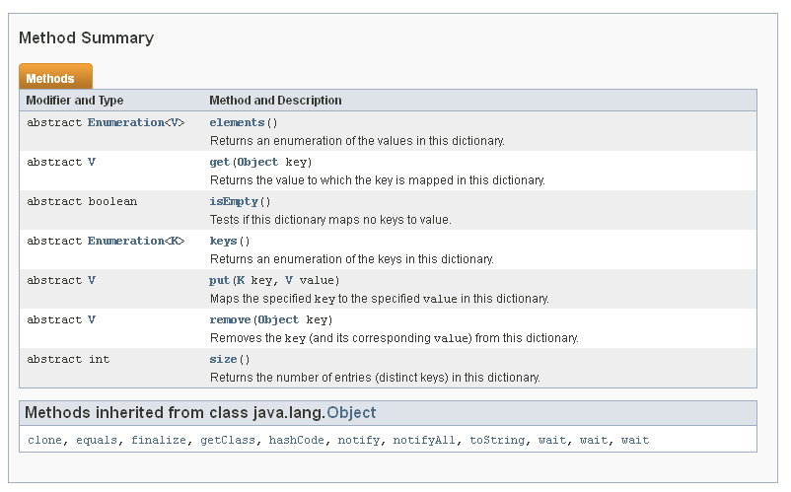

Slide 5
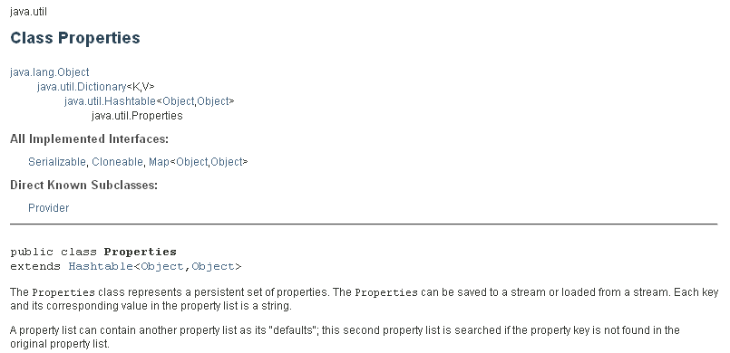
Properties
Properties is a subclass of Hashtable. It is used to maintain lists of values in which the key is a String and the value is also a String.
The Properties class is used by many other Java classes. For example, it is the type of object returned by System.getProperties( ) when obtaining environmental values.

Slide 6
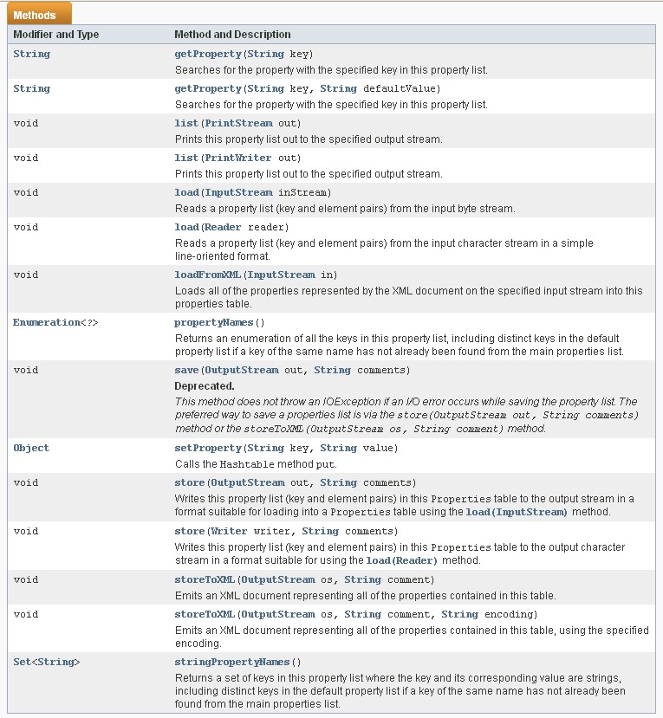

Slide 7
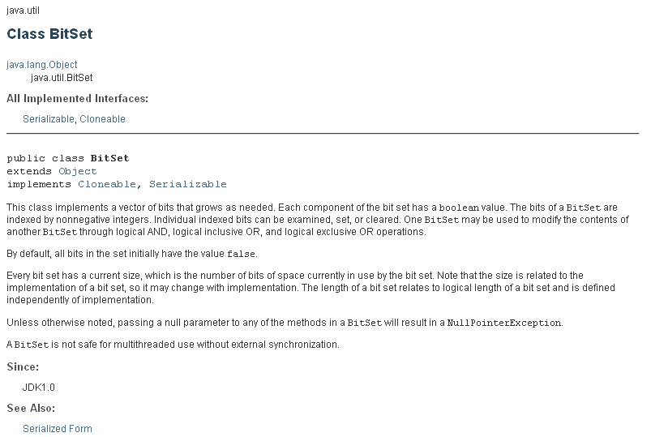
BitSet
A BitSet class creates a special type of array that holds bit values. The BitSet array can increase in size as needed. This makes it similar to a vector of bits.

Slide 8
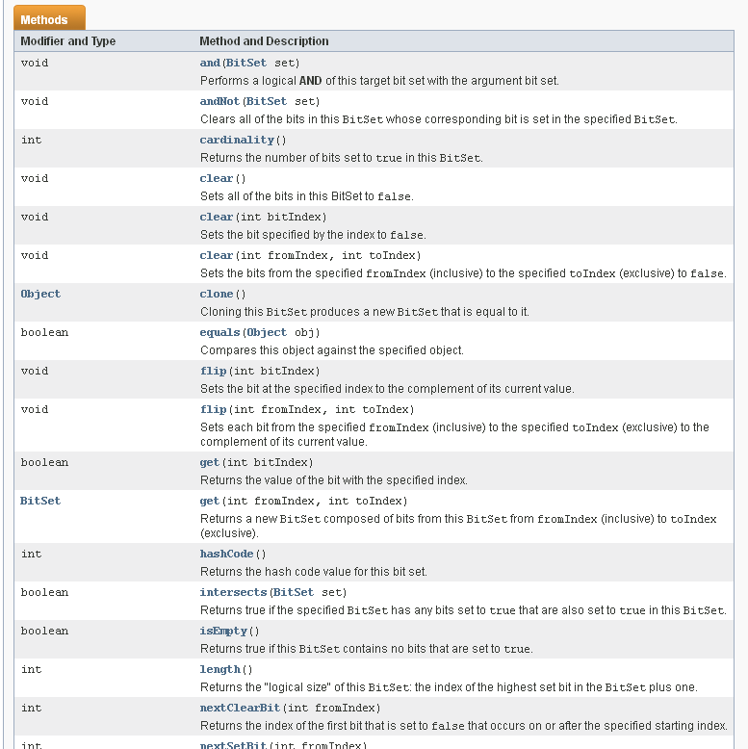

Slide 9
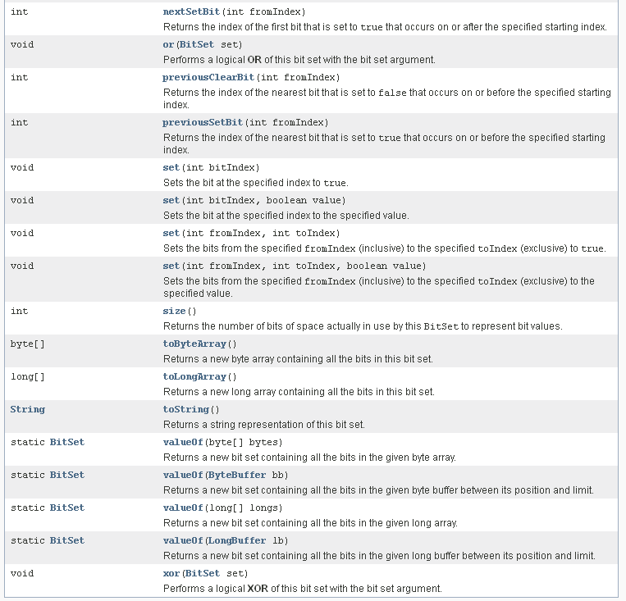

Slide 10
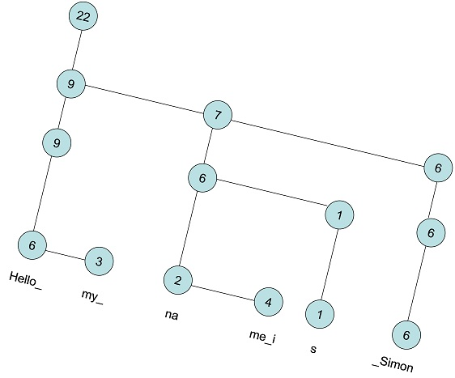
ROPE
A rope, or cord, is a data structure for efficiently storing and manipulating a very long string. For example, a text editing program may use a rope to represent the text being edited, so that operations such as insertion, deletion, and random access can be done efficiently. It is a binary tree.

Slide 11
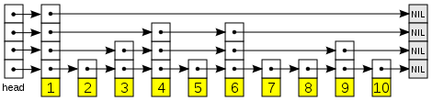
Skip Lists
A skip list is a data structure for storing a sorted list of items using a hierarchy of linked lists that connect increasingly sparse subsequences of the items. These auxiliary lists allow item lookup with efficiency comparable to balanced binary search trees (that is, with number of probes proportional to log n instead of n).
Each link of the sparser lists skips over many items of the full list in one step, hence the structure's name.

Slide 12
Disjoint-Set
A disjoint-set data structure is a data structure that keeps track of a set of elements partitioned into a number of disjoint (nonoverlapping) subsets. A union-find algorithm is an algorithm that performs two useful operations on such a data structure:
Find: Determine which subset a particular element is in. This can be used for determining if two elements are in the same subset.
Union: Join two subsets into a single subset.
Because it supports these two operations, a disjoint-set data structure is sometimes called a union-find data structure or merge-find set. The other important operation, MakeSet, which makes a set containing only a given element (a singleton), is generally trivial. With these three operations, many practical partitioning problems can be solved.
Disjoint-set data structures model the partitioning of a set, for example to keep track of the connected components of an undirected graph. This model can then be used to determine whether two vertices belong to the same component, or whether adding an edge between them would result in a cycle.

Slide 13
Cuckoo Hashing
Cuckoo hashing is a scheme for resolving hash collisions of values of hash functions in a hashtable. The name derives from the behavior of some species of cuckoo, where the cuckoo chick pushes the other eggs or young out of the nest when it hatches.
The basic idea is to use two hash functions instead of only one. This provides two possible locations in the hash table for each key. In one of the commonly used variants of the algorithm, the hash table is split into two smaller tables of equal size, and each hash function provides an index into one of these two tables.
The new key is inserted in one of its two possible locations, "kicking out", that is, displacing, any key that might already reside in this location. This displaced key is then inserted in its alternative location, again kicking out any key that might reside there, until a vacant position is found, or the procedure enters an infinite loop. In the latter case, the hash table is rebuilt in-place using new hash functions.

Slide 14
A quad-edge data structure is a computer representation of the topology of a two-dimensional or three-dimensional map, that is, a graph drawn on a (closed) surface.
The doubly connected edge list (DCEL) is a data structure to represent an embedding of a planar graph in the plane and polytopes in 3D. This data structure provides efficient manipulation of the topological information associated with the objects in question (vertices, edges, faces). It is used in many algorithms of computational geometry to handle polygonal subdivisions of the plane, commonly called planar straight-line graphs (PSLG).
Unions
C style unions allow the same bit pattern to be interpreted in multiple ways.
Not available in Java
union
{
char key;
int num;
double volts;
}
This union contains a single member that can be a
char, int or double

Slide 15
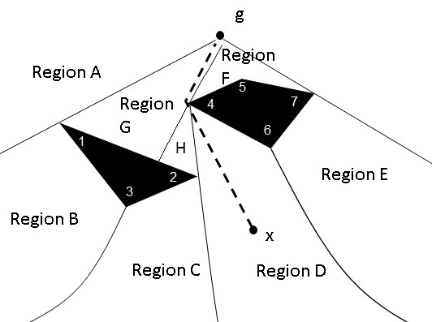
Shortest Path Maps
In robotics or many other applications, we want to find the shortest path from a given point to any other place on the map.
Given a terrain representation where the underlying terrain allows for a fixed speed, and polyonal obstacles are placed throughout, we can find a shortest path map.
Example:

Slide 16
Shortest Path Maps
For this example, there are only eight regions of similarly-behaved paths, so if these regions are stored in a binary search tree, it takes at most 3 checks (log₂ n) of the destination (‘x’ in the example) to find what region to go to.
The resulting path could then be specified by listing the turn-points, in this case
g -> 4 -> x.

Slide 17
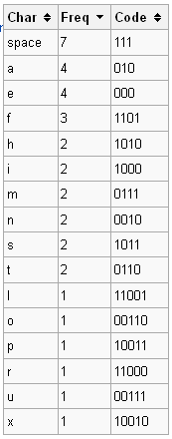
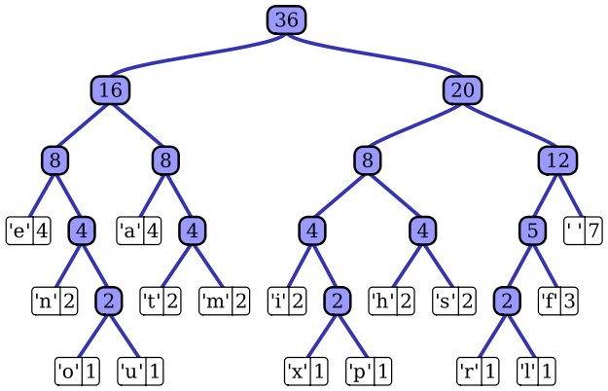
Huffman Trees
Huffman coding is an entropy encoding algorithm used for lossless data compression. The term refers to the use of a variable-length code table for encoding a source symbol (such as a character in a file) where the variable-length code table has been derived in a particular way based on the estimated probability of occurrence for each possible value of the source symbol. Uses a priority queue based on frequency.
Huffman tree generated from the exact frequencies in the sentence "this is an example of a huffman tree".

Slide 18
Huffman Trees – how to build
The first step is to compute the frequency of each character in the file you wish to encode. This allows you to determine which characters should have the fewest bits, etc. The next step is to build a “coding tree” from the bottom up according to the frequencies. An example will help make this clear. To make the example easier, suppose we only want to encode the five letters (a, b, c, d, e) and they have frequencies 3, 3, 1, 1, and 2, respectively.
We first create a leaf node for each character/frequency pair and put them into a priority queue, so that the characters with lower frequencies appear first:
1
‘c’
1
‘d’
2
‘e’
3
‘a’
3
‘b’

Slide 19
Huffman Trees – how to build
Now we pick the two nodes with the smallest frequencies (the two at the front of the priority queue) and create a new node with those two nodes as children (the first value from the queue becomes the left, the second value from the queue becomes the right). We assign this new branch node a frequency that is the sum of the frequencies of the two children. This new node is then put back into the priority queue:
2
‘e’
2
-
3
‘a’
3
‘b’
1
‘c’
1
‘d’

Slide 20
Huffman Trees – how to build
Continuing in this way, we build up larger and larger subtrees.
3
‘a’
3
‘b’
4
-
2
‘e’
2
-
1
‘c’
1
‘d’
4
-
6
-
2
‘e’
2
-
3
‘a’
3
‘b’
1
‘c’
1
‘d’

Slide 21
Huffman Trees – how to build
And finally
char | freq | code
b | 3 | 11
a | 3 | 10
e | 2 | 00
d | 1 | 011
c | 1 | 010
10
-
4
-
6
-
2
‘e’
2
-
3
‘a’
3
‘b’
1
‘c’
1
‘d’
The Huffman code is derived from this coding tree simply by assigning a zero to each left branch and a one to each right branch. The code can be read directly from the tree. The code for a is 10, the code for b is 11, the code for c is 010, the code for d is 011 and the code for e is 00.

Slide 22
Huffman Trees – how to use
char | freq | code
b | 3 | 11
a | 3 | 10
e | 2 | 00
d | 1 | 011
c | 1 | 010
-
-
-
2
‘e’
-
3
‘a’
3
‘b’
1
‘c’
1
‘d’
Given the following code sequence, figure out the text:
1011001011011000101110
Traverse the tree until find a leaf – put character in queue
Answer: abeabdecba

Slide 23
Huffman Trees – Example
Compute the frequency of each character
Example: for the string “better tree”
freq_{b}=1, freq_{e}=4, freq_{t}=3, freq_{r}=2, freq_{Space}=1
Build a “coding tree”
Insert characters into a priority queue, lower-frequency first
Example: consider each character as a node with char & freq
b | 1
Sp | 1
r | 2
t | 3
e | 4
Remove first two characters (ie, two with lowest frequency)
Create a new node, with these two characters as children; new node has a “freq” of the combined frequency of the two children
Insert new node in priority queue in correct position
Example:
Repeat until there is a single tree
r | 2
- | 2
t | 3
e |4
b | 1
Sp| 1

Slide 24
Huffman Trees – Example
Repeat until there is a single tree
t | 3
e |4
- |4
r | 2
- | 2
b | 1
Sp| 1
- |4
- |7
r | 2
- | 2
t | 3
e |4
- |11
b | 1
Sp| 1
- |4
- |7
r | 2
- | 2
t | 3
e |4
b | 1
Sp| 1

Slide 25
Huffman Trees – Example
Now code each character by its position in the tree:
Start at the root
Left branch gets a 0
Right branch gets a 1
- |11
char | freq | code
e | 4 | 11
t | 2 | 10
r | 1 | 00
Space | 1 | 011
b | 1 | 010
0 1
00 01 10 11
010 011
- |4
- |7
r | 2
- | 2
t | 3
e |4
b | 1
Sp| 1
Finally build a string: for “beet reet”– 01011111001100111110
NOTE: each code is unique, i.e., you can decode left-to-right.
Example: Decode - 01011111001100111110
010
b
11
e
11
e
10
t
011
__
00
r
11
e
11
e
10
t

Slide 26
Huffman Trees – English Alphabet
A Huffman Tree built from the typical frequency of the letters in the English alphabet looks like this:
-
0 1
00 01 10 11
010 001 010 011 100 101 110 111
0010 0011 0100
0101 0110 0111 1010 1011 1100 1101 1110 1111
00100 00101 00110 00111 01000 01001 11000 11001 11100 11111
001110 001111 110000 110001 111000 111001
0011110 0011111
00111100 00111101
001111000 001111001 001111010 001111011
-
-
-
-
-
-
t
-
-
-
e
-
-
-
-
-
-
r
h
s
n
i
-
o
a
-
f
w
m
-
u
c
-
l
-
d
v
-
b
p
y
g
-
k
-
-
See next slide for the coding chart
z
q
x
j

Slide 27
Huffman Trees – English Alphabet
The Huffman coding chart built from the typical frequency of the letters in the English alphabet (https://en.wikipedia.org/wiki/Letter_frequency):
char | freq | code
e | 127 | 100
t | 91 | 010
r | 60 | 0101
h | 61 | 0110
s | 63 | 0111
n | 67 | 1010
i | 70 | 1011
o | 75 | 1101
a | 82 | 1110
f | 22 | 00100
w | 24 | 00101
m | 24 | 00110
u | 28 | 01000
char | freq | code
c | 28 | 01001
l | 40 | 11001
d | 43 | 11111
v | 10 | 001110
b | 15 | 110000
p | 19 | 110001
y | 20 | 111000
g | 20 | 111001
k | 8 | 0011111
z | 1 | 001111000
q | 1 | 001111001
x | 2 | 001111010
j | 2 | 001111011

